Slide 1
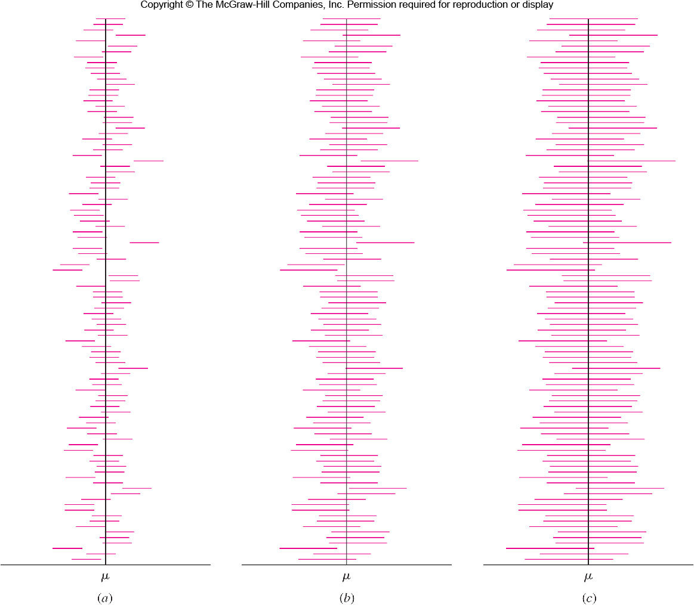
Figure 5.5
$$\overline{x}±1.0\frac{s}{\sqrt{n}}$$
$$\overline{x}±1.96\frac{s}{\sqrt{n}}$$
$$\overline{x}±2.576\frac{s}{\sqrt{n}}$$

Slide 2
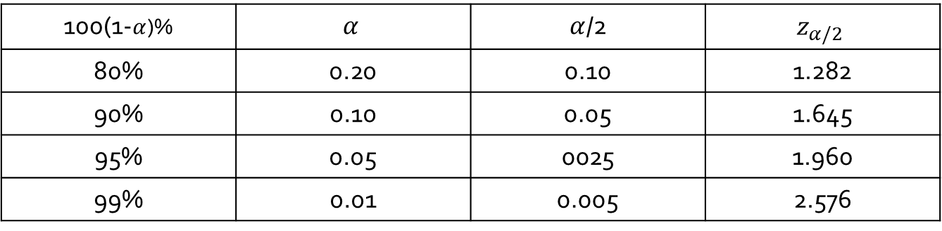

Other levels of confidence
The multiplier 1.96 is determined from probabilities of the standard normal curve.
In general, a 100(1-$α$)% confidence interval on $μ$ ( when $σ$ is known) is
$\overline{x}±z_{α/2}\frac{σ}{\sqrt{n}}$
Some common values of the multiplier are
$P\left({−z}_{α/2}<\frac{\overline{X}−μ}{\frac{σ}{\sqrt{n}}}<z_{α/2}\right)=1−α →$ $P\left(\overline{X}−z_{α/2}\frac{σ}{\sqrt{n}}<μ<\overline{X}+z_{α/2}\frac{σ}{\sqrt{n}}\right)=1−α$
100(1-$α$)% | $$α$$ | $α$/2 | $$z_{α/2}$$
80% | 0.20 | 0.10 | 1.282
90% | 0.10 | 0.05 | 1.645
95% | 0.05 | 0025 | 1.960
99% | 0.01 | 0.005 | 2.576

Slide 3
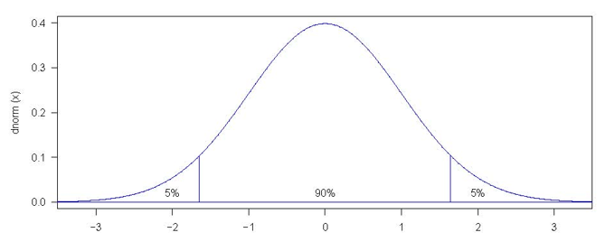

Graph showing critical values
For a 90% confidence interval we use $z_{α/2}$=$z_{0.05}$=1.645.
When the standard normal curve is divided at -1.645 and 1.645, it has 5% of the area in the left tail, 90% in the middle, and 5% in the right tail.

Slide 4
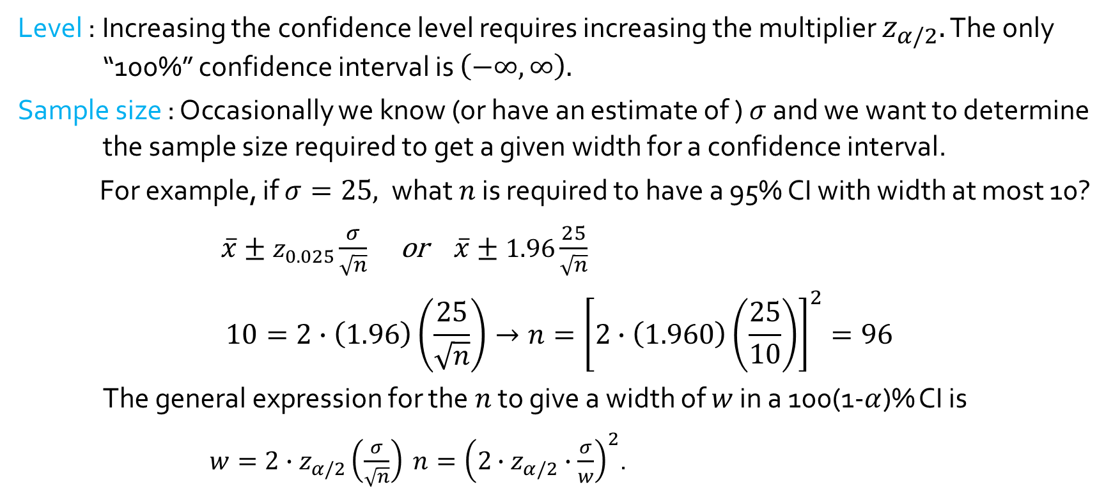
Confidence Level, Precision, and Sample Size
Level : Increasing the confidence level requires increasing the multiplier $z_{α/2}.$ The only “100%” confidence interval is $\left(−∞, ∞\right).$
Sample size : Occasionally we know (or have an estimate of ) $σ$ and we want to determine the sample size required to get a given width for a confidence interval.
For example, if $σ=25,$what $n$ is required to have a 95% CI with width at most 10?
$\overline{x}±z_{0.025}\frac{σ}{\sqrt{n}}$ or $\overline{x}±1.96\frac{25}{\sqrt{n}}$
$$10=2∙\left(1.96\right)\left(\frac{25}{\sqrt{n}}\right)→n={\left[2∙\left(1.960\right)\left(\frac{25}{10}\right)\right]}^{2}=96$$
The general expression for the $n$ to give a width of $w$ in a 100(1-$α$)% CI is
$w=2∙z_{α/2}\left(\frac{σ}{\sqrt{n}}\right) n={\left(2∙z_{α/2}∙\frac{σ}{w}\right)}^{2}$.

